Slide 1
Domain Adversarial Training of Neural Network
상진이와 함께 이해하는
Jin Sang
Master @YONSEI
10TH 8, 2017
* Domain Adversarial Training of Neural Network, Y. Ganin et al. 2016를 바탕으로 작성한 리뷰

Slide 2
Usually we try to…
Training
(source)
Test
(target)

Slide 3
For simplicity, let’s consider the binary classification problem

Slide 5
일반적인 supervised learning setting: Training과 test의 domain이 같다고 가정.

Slide 9
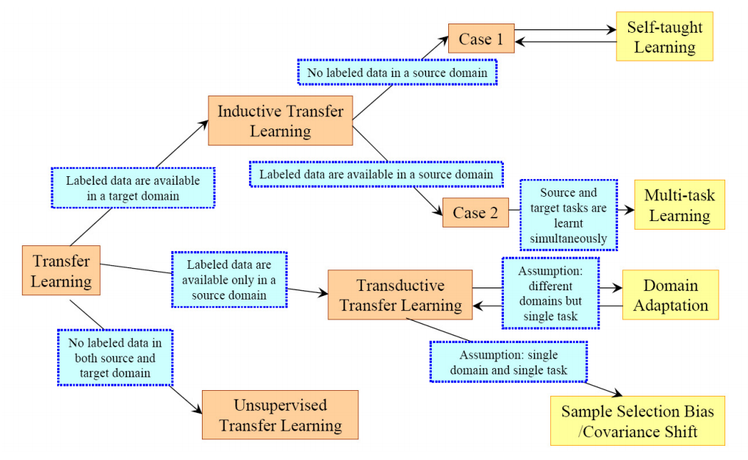
TAXONOMY OF TRANSFER LEARNING

Slide 13
전자기기 고객평가 (X) / 긍정 혹은 부정 라벨 (Y)

Slide 14
전자기기 고객평가 (X) / 긍정 혹은 부정 라벨 (Y)
비디오 게임 고객평가 (X)

Slide 15
전자기기 고객평가 (X) / 긍정 혹은 부정 라벨 (Y)
비디오 게임 고객평가 (X)
NN으로 표현되는 H 함수 공간으로부터….

Slide 16
전자기기 고객평가 (X) / 긍정 혹은 부정 라벨 (Y)
비디오 게임 고객평가 (X)
NN으로 표현되는 H 함수 공간으로부터….
Classifier h를 학습하는데, target의 label을 모르지만 source(X,Y)와 target(X)
두 도메인 모두에서 잘 label을 찾는 h를 찾고 싶다.

Slide 17
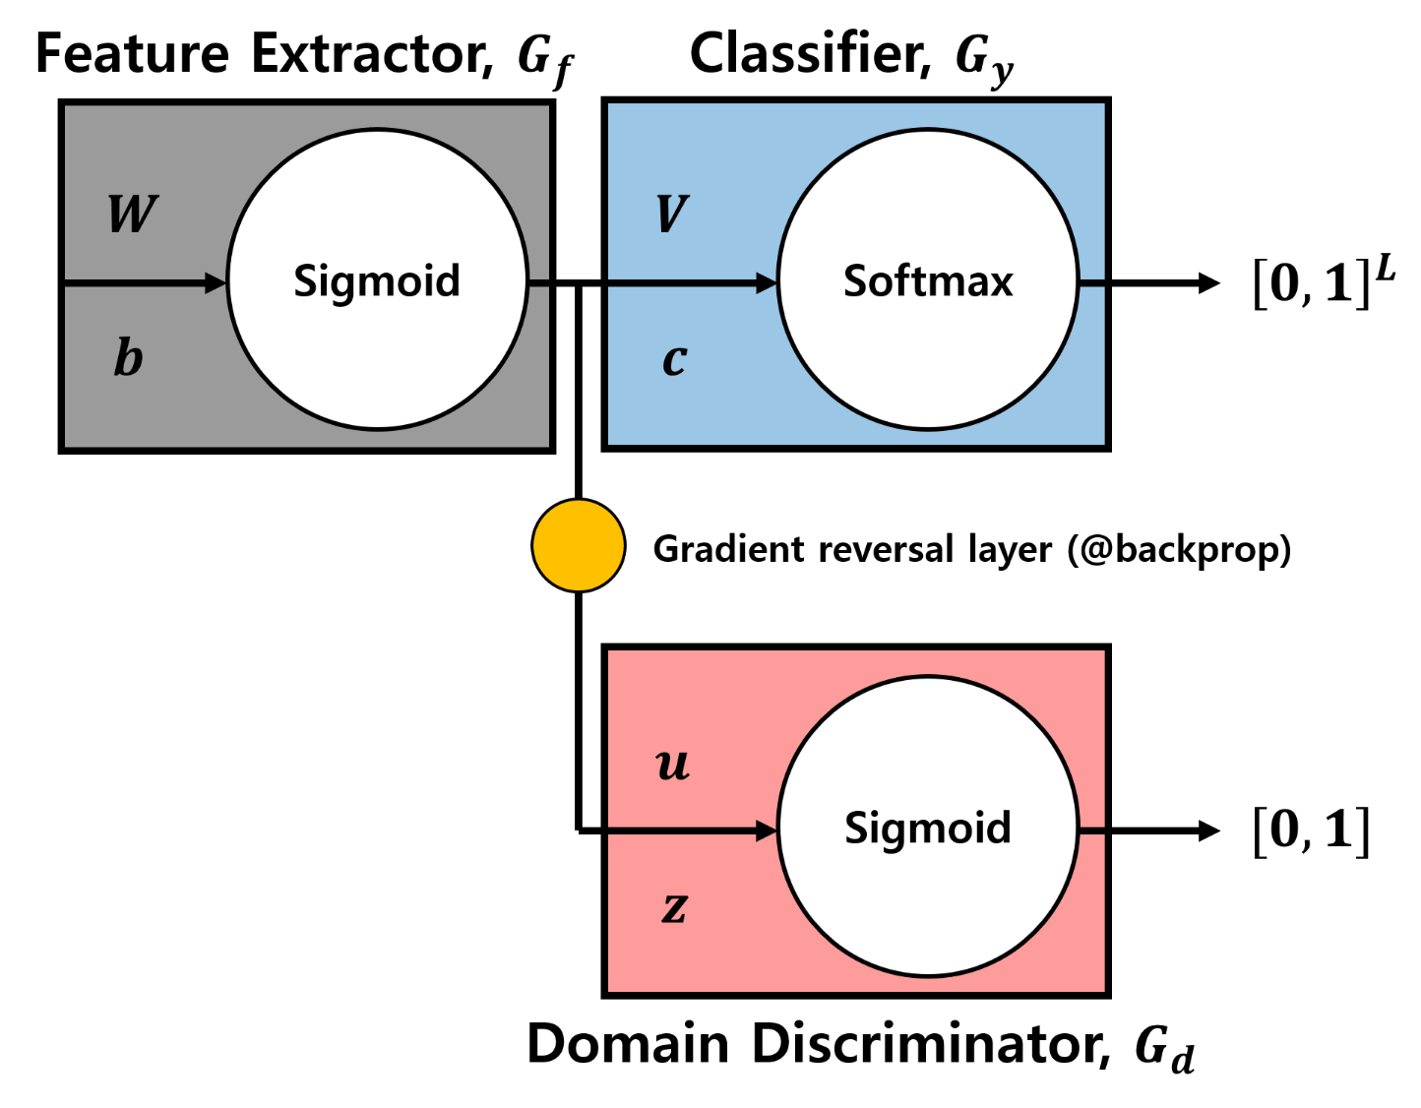
DANN

Slide 18
DANN
TRY TO CLASSIFY WELL WITH
THE EXTRACTED FEATURE!
POSITIVE
NEGATIVE
고객 평가 댓글
Ordinary classification

Slide 19
DANN
TRY TO CLASSIFY WELL WITH
THE EXTRACTED FEATURE!
POSITIVE
NEGATIVE
고객 평가 댓글
Ordinary classification
전자기기
비디오 게임
Domain Classification

Slide 20
DANN
TRY TO CLASSIFY WELL WITH
THE EXTRACTED FEATURE!
POSITIVE
NEGATIVE
고객 평가 댓글
Ordinary classification
TRY TO EXTRACT
DOMAIN INDEPENDENT FEATURE!
전자기기
비디오 게임
Domain Classification

Slide 21

DANN
TRY TO CLASSIFY WELL WITH
THE EXTRACTED FEATURE!
POSITIVE
NEGATIVE
고객 평가 댓글
Ordinary classification
TRY TO EXTRACT
DOMAIN INDEPENDENT FEATURE!
e.g. f : compact, sharp, blurry
$→$ easy to discriminate the domain
$$⇓$$
f : good, excited, nice, never buy, …
전자기기
비디오 게임
Domain Classification

Slide 22
DANN
Combining DA and feature learning within one training process
Principled way to learn a good representation based on the generalization guarantee
: minimize the H divergence directly (no heuristic)
“When or when not the DA algorithm works.”
“Why it works.”

Slide 23
기존 전략: 최대한 적은 parameter로 training error가 최소인 model을 찾자

Slide 24
이제는 training domain (source)과 testing domain (target)이 서로 다르다
기존의 전략 외에 다른 전략이 추가로 필요하다.

Slide 26
PREREQUISITE
Different distances
Slide courtesy of Sungbin Lim, DeepBio, 2017

Slide 27
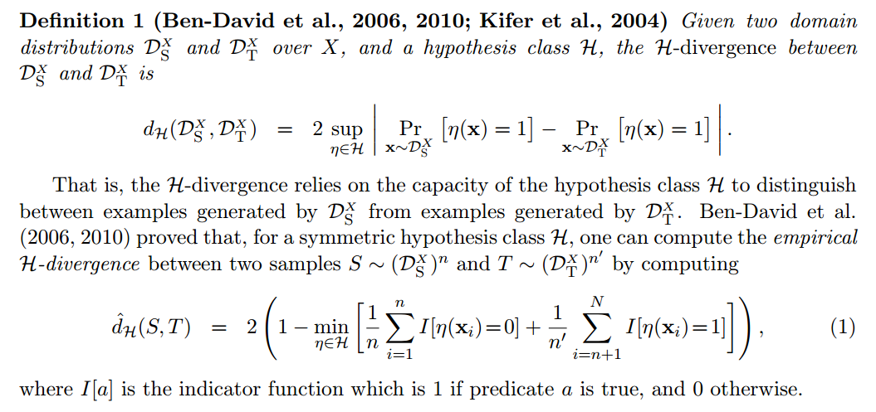
THEORETICAL RESULTS

Slide 28
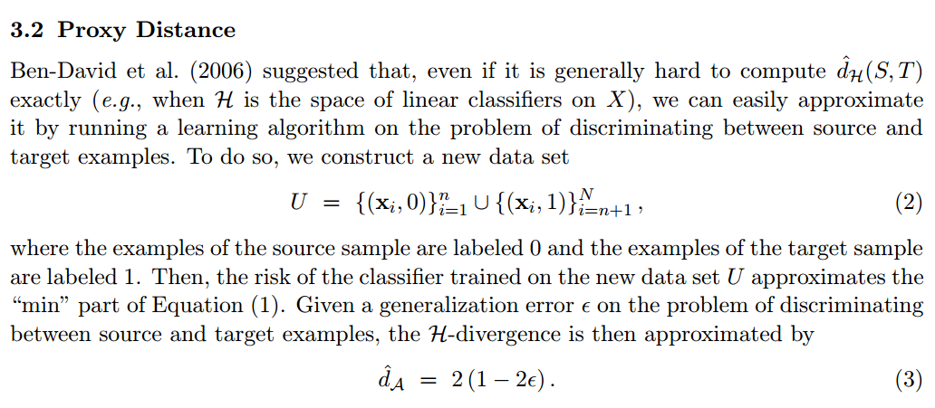
THEORETICAL RESULTS

Slide 29

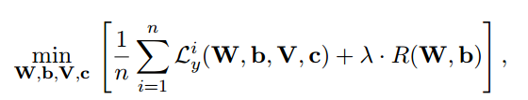
DANN

Slide 30
DANN

Slide 31
DANN

Slide 32
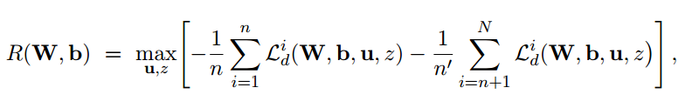


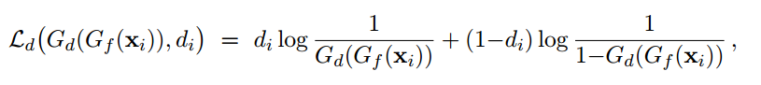
DANN

Slide 33


DANN
$$↔$$

Slide 34
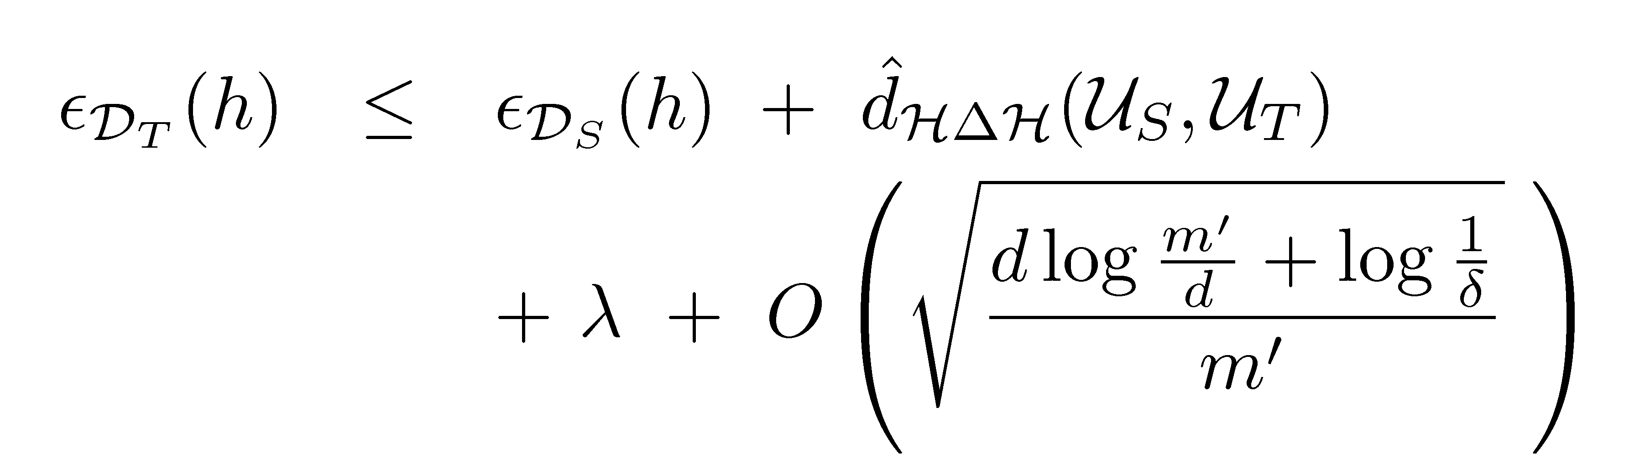
DANN
$$↔$$

Slide 35
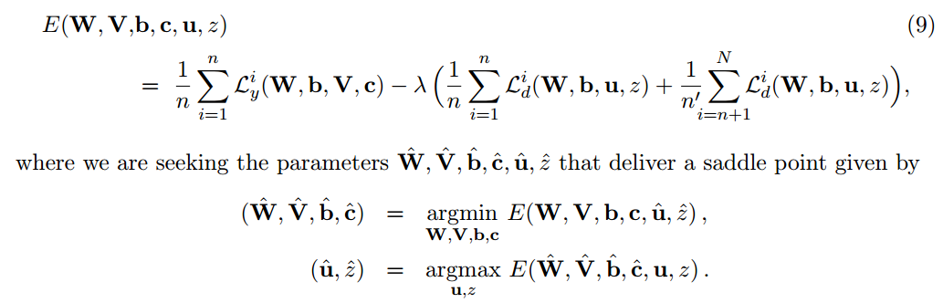
DANN

Slide 37
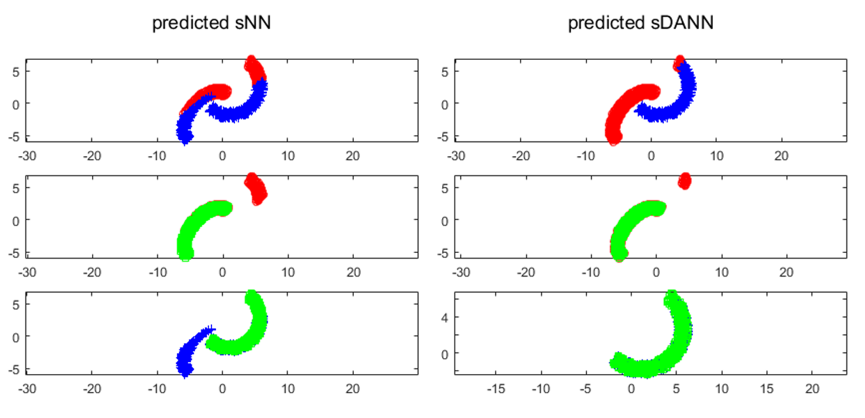
SHALLOW DANN

Slide 38
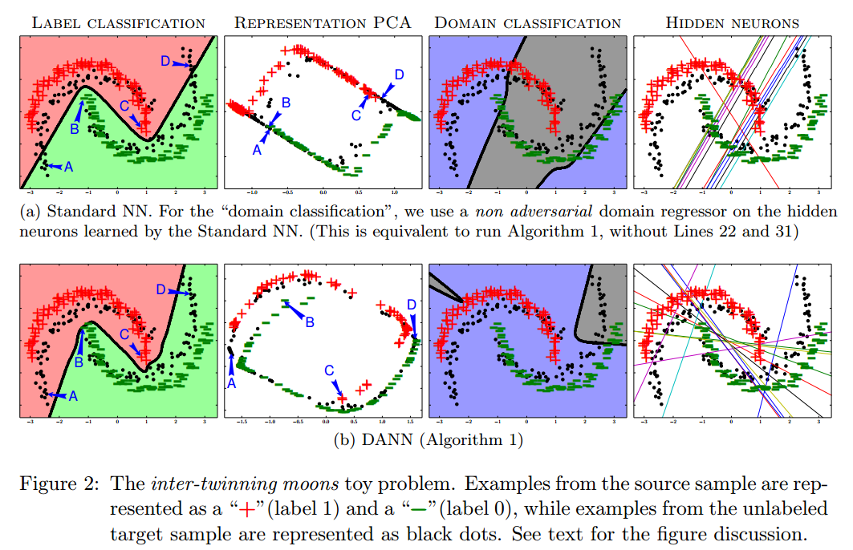
SHALLOW DANN

Slide 39
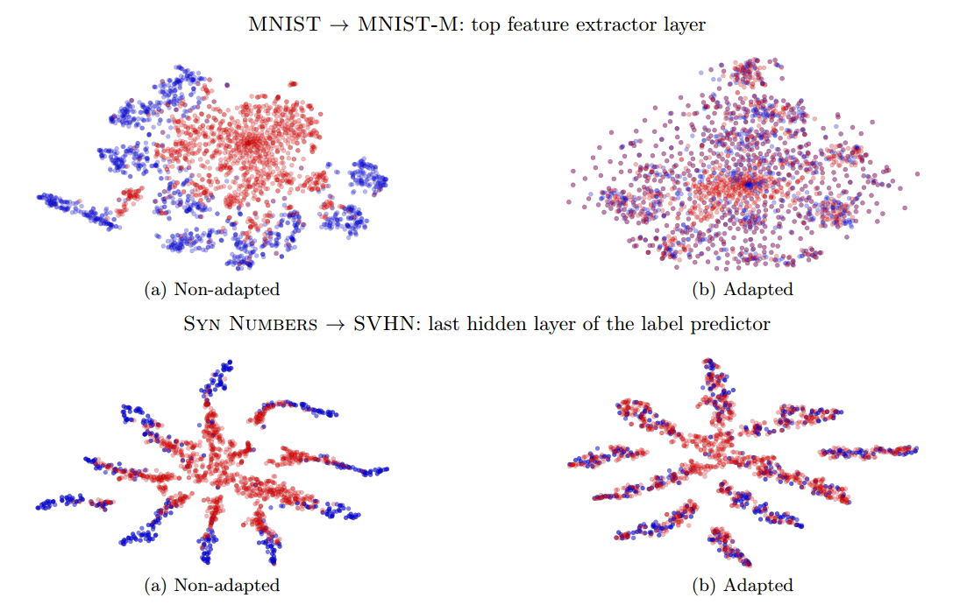
tSNE RESULTS

Slide 40
REFERENCE
PAPERS
A survey on transfer learning, SJ Pan 2009
A theory of learning from different domains, S Ben-David et al. 2010
Domain-Adversarial Training of Neural Networks, Y Ganin 2016
BLOG
http://jaejunyoo.blogspot.com/2017/01/domain-adversarial-training-of-neural.html
https://github.com/jaejun-yoo/tf-dann-py35
https://github.com/jaejun-yoo/shallow-DANN-two-moon-dataset
SLIDES
http://www.di.ens.fr/~germain/talks/nips2014_dann_slides.pdf
http://john.blitzer.com/talks/icmltutorial_2010.pdf (DA theory part)
https://epat2014.sciencesconf.org/conference/epat2014/pages/slides_DA_epat_17.pdf (DA theory part)
https://www.slideshare.net/butest/ppt-3860159 (DA theory part)
VIDEO
https://www.youtube.com/watch?v=h8tXDbywcdQ (Terry Um 딥러닝 토크)
https://www.youtube.com/watch?v=F2OJ0fAK46Q (DA theory part)
https://www.youtube.com/watch?v=uc6K6tRHMAA&index=13&list=WL&t=2570s (DA theory part)

